Slide 1
Contract Management in electrical engineering
Alfresco Community in a critical, regulated process

Slide 2
Highlights
Alfresco Community in a business critical process
Faceted search as primary access to documents
Interfacing with legacy systems
Small customizations to achieve major business goals
Connecting Ephesoft and Alfresco with Activiti Cloud

Slide 3
Business critical process
Company founded in 1876
Projects and maintenance in electrical engineering
2.500 employees
Revenue (2014) 364 million
Management of contracts and service dossiers

Slide 4
The project
Phase 1 (Delivered):
Conversion
Converting folder structure to flat contract dossiers
Tagging documents using business rules with metadata coming from the ERP system
Interfacing
Initial interface to the ERP system for tagging new incoming documents
Receiving service order information from planning and order management system
Receiving digital forms from maintenance and inspections

Slide 5
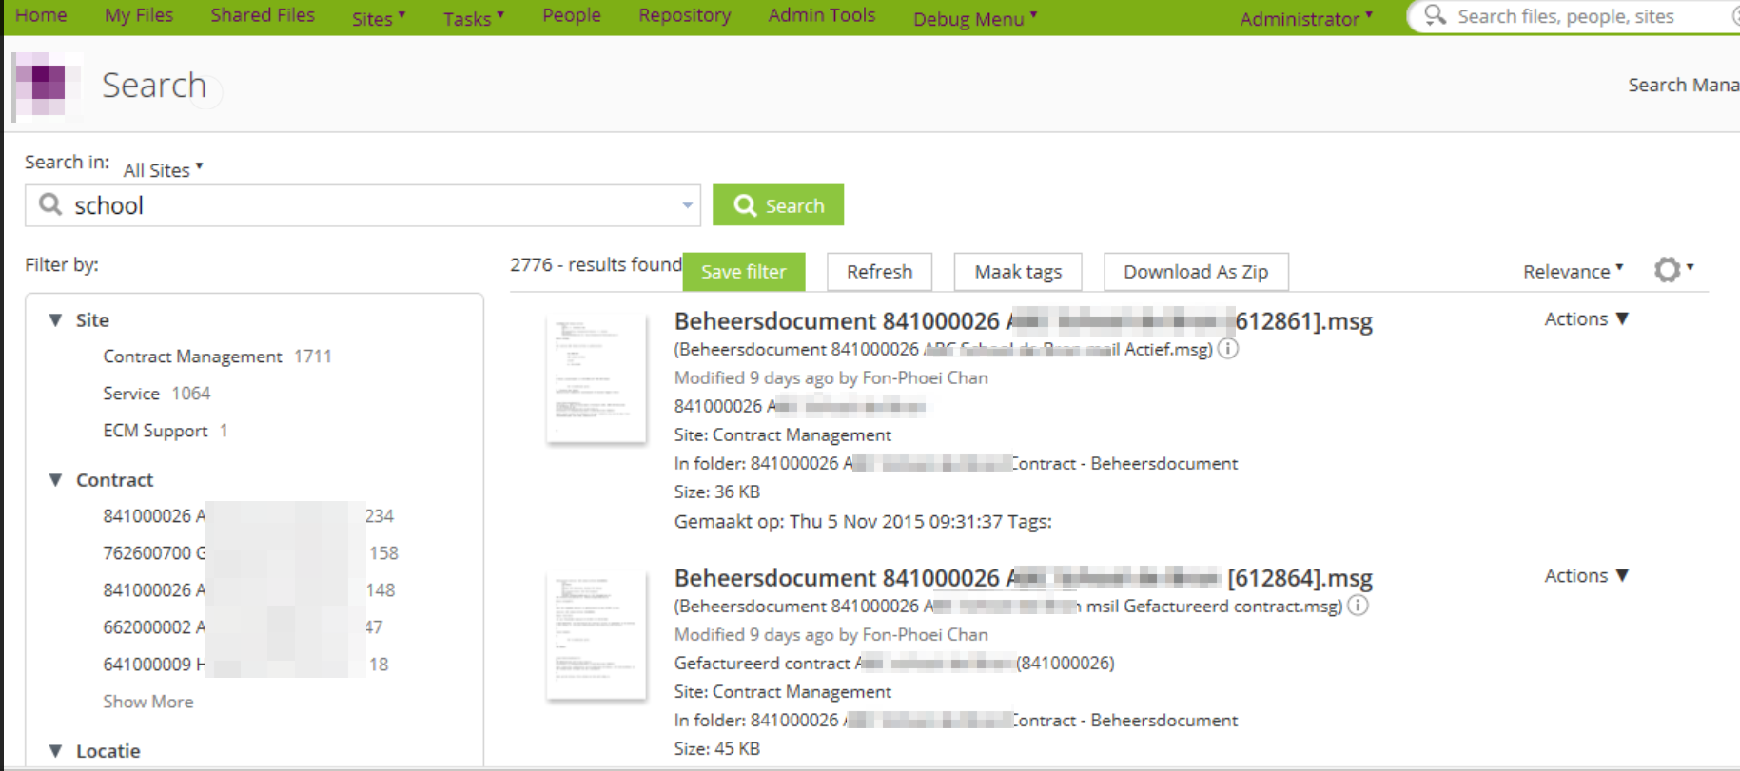
The project
Phase 1 (Delivered):
Implementing facetted search

Slide 6
The project
Phase 2 (Planned):
Publication and collaboration
Granting customers access to their service files
Allowing subcontractors to upload their documentation
Capturing incoming physical documents (screen cast)
Scanning by Ephesoft
Approval by Activiti

Slide 7
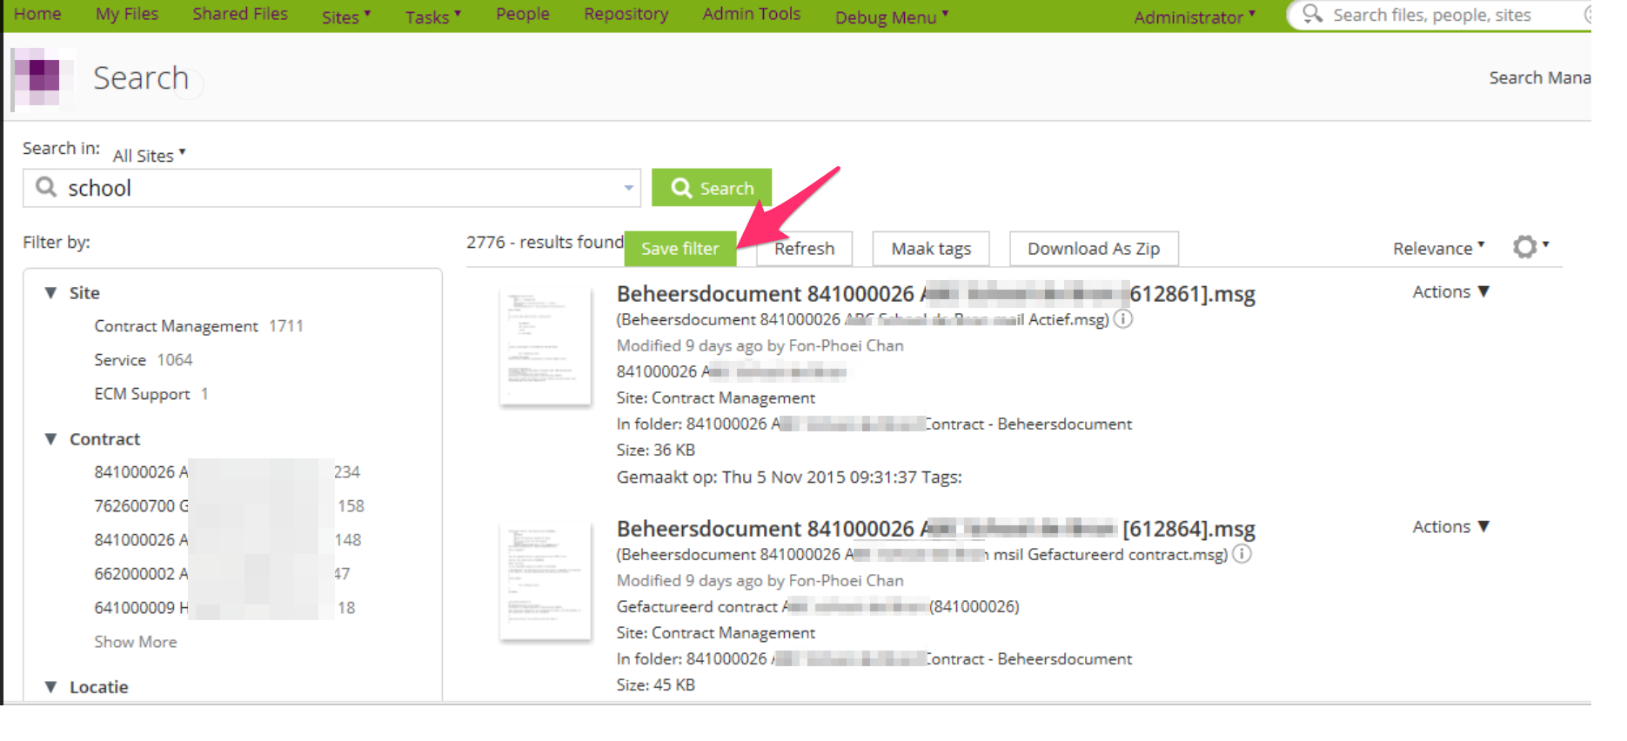
Customizations for major business goals
Save filter

Slide 8
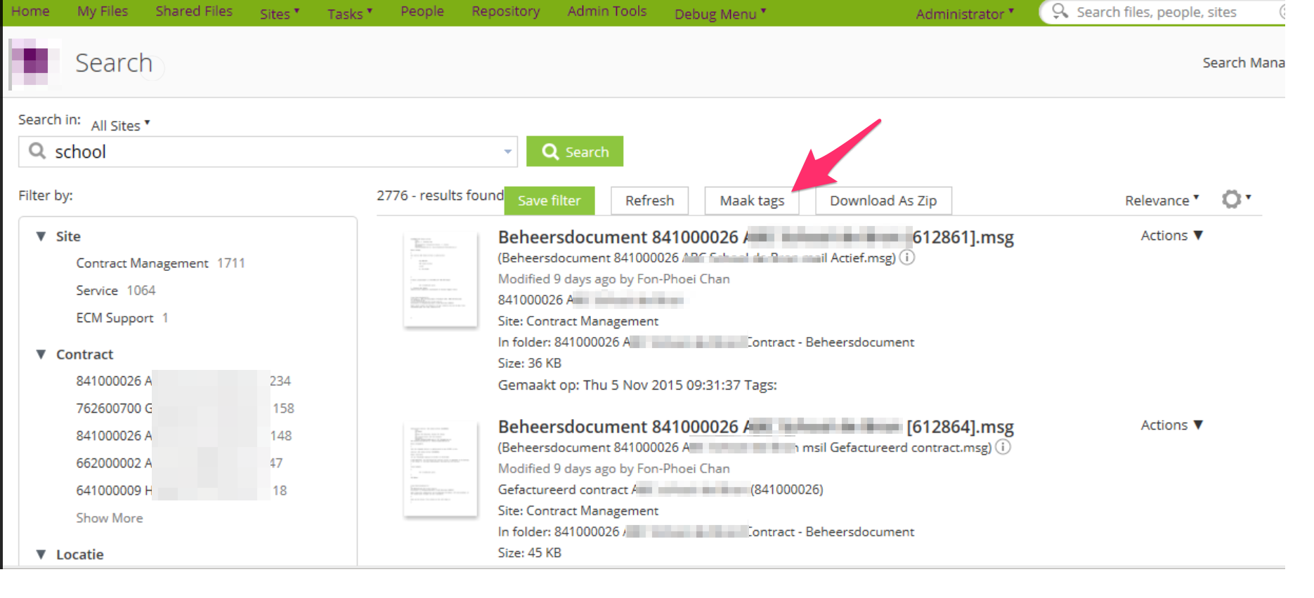
Customizations for major business goals
Create Tags

Slide 9
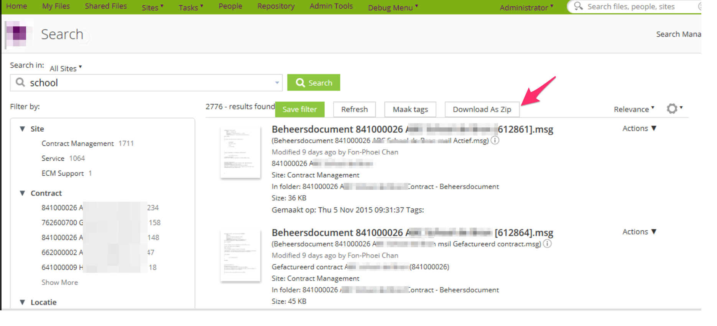
Customizations for major business goals
Download all results as zip

Slide 10
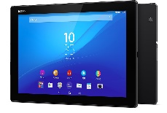



Activiti Workflow
Pilot: Implement purchase order validation process;
TABLET
CONTENT REPOSITORY
ACTIVITI CLOUD
OCR

Slide 11
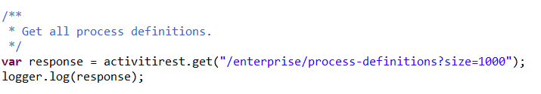
Activiti Workflow
Created a REST client interface;
Extends BaseScopableProcessorExtension class for easy access through JavaScript;

Slide 12
Activiti Workflow
Use Case: Document is stored in Alfresco. Inbound rule triggers workflow creation in Activiti Cloud. Add document to task.
Steps in Activiti Cloud
Create process;
Get TaskId;
Attach document to task.

Slide 13
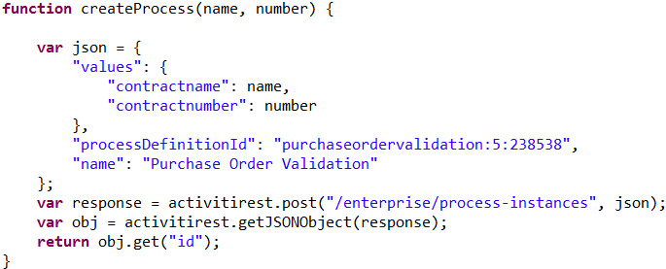
Activiti Workflow
Create process

Slide 14
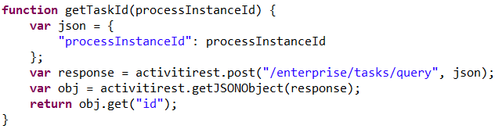
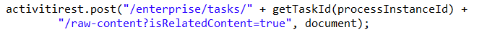
Activiti Workflow
Get Task ID
Add document

Slide 15
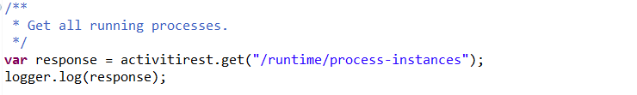
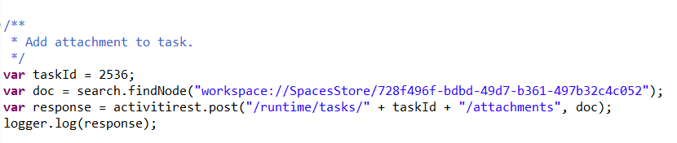
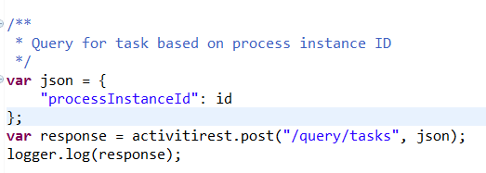
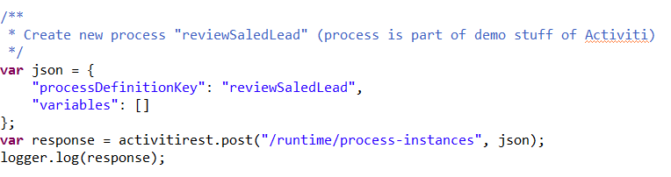
Activiti Workflow

Slide 16

Activiti Workflow
Cloud (also for trial accounts)
activitirest.url=https://activiti.alfresco.com/activiti-app/api
activitirest.userName=
activitirest.password=
Community (Activiti 5)
activitirest.url=http://localhost:8090/activiti-rest/service
activitirest.userName=kermit
activitirest.password=Kermit
DEMO

